Slide 1
Divide and Conquer (Greedy Methods)

Slide 2
Greedy Methods
A greedy algorithm:
is any algorithm that follows the problem solving metaheuristic of making the locally optimal choice at each stage with the hope of finding the global optimum.
A metaheuristic method:
Is method for solving a very general class of computational problems that aims on obtaining a more efficient or more robust procedure for the problem.
Generally it is applied to problems for which there is no satisfactory problem-specific algorithm designed to solve it.
It targeted to the combinatorial optimization (problems that’s are a problems in which has an optimization function to( minimize or maximize) subject to some constraints and its goal is to find the best possible solution

Slide 3
Examples
The vehicle routing problem (VRP)
A number of goods need to be moved from certain pickup locations to other delivery locations. The goal is to find optimal routes for a fleet of vehicles to visit the pickup and drop-off locations.
Travelling salesman problem
Given a list of cities and their pair wise distances, the task is to find a shortest possible tour that visits each city exactly once.
Coin Change
(making change for n $ using minimum number of coins)
The knapsack problem
The Shortest Path Problem

Slide 4
KNAPSACK
The knapsack problem or rucksack problem is a problem in combinatorial optimization. It derives its name from the following maximization problem of the best choice of essentials that can fit into one bag to be carried on a trip. Given a set of items, each with a weight and a value, determine the number of each item to include in a collection so that the total weight is less than a given limit and the total value is as large as possible.

Slide 5
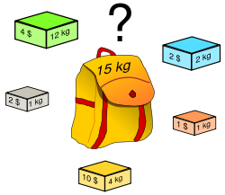
The Original Knapsack Problem (1)
Problem Definition
Want to carry essential items in one bag
Given a set of items, each has
A cost (i.e., 12kg)
A value (i.e., 4$)
Goal
To determine the # of each item to include in a collection so that
The total cost is less than some given cost
And the total value is as large as possible

Slide 6
The Original Knapsack Problem (2)
Three Types
0/1 Knapsack Problem
restricts the number of each kind of item to zero or one
Bounded Knapsack Problem
restricts the number of each item to a specific value
Unbounded Knapsack Problem
places no bounds on the number of each item
Complexity Analysis
The general knapsack problem is known to be NP-hard
No polynomial-time algorithm is known for this problem
Here, we use greedy heuristics which cannot guarantee the optimal solution

Slide 7
Fractional Knapsack Problem
In fractional knapsack problem, where we are given a set S of n items, s.t., each item I has a positive benefit b_{i} and a positive weight w_{i}, and we wish to find the maximum-benefit subset that doesn’t exceed a given weight W.
We are also allowed to take arbitrary fractions of each item.

Slide 8
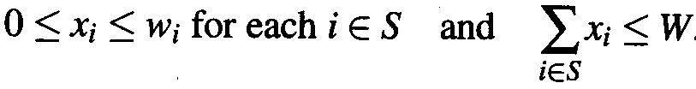

Fractional Knapsack Problem
I.e., we can take an amount x_{i} of each item i such that
The total benefit of the items taken is determined by the objective function

Slide 9
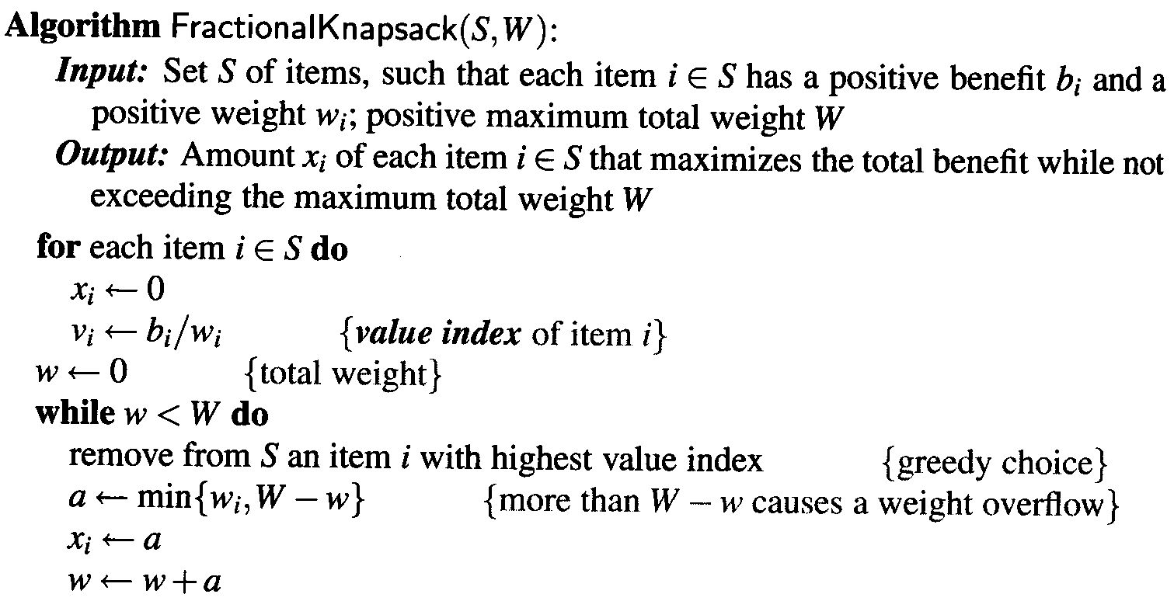
Fractional Knapsack Problem

Slide 10
Fractional Knapsack Problem
In the solution we use a heap-based PQ to store the items of S, where the key of each item is its value index
With PQ, each greedy choice, which removes an item with the greatest value index, takes O(log n) time
The fractional knapsack algorithm can be implemented in time O(n log n).

Slide 11
Fractional Knapsack Problem
Fractional knapsack problem satisfies the greedy-choice property, hence
Thm: Given an instance of a fractional knapsack problem with set S of n items, we can construct a maximum benefit subset of S, allowing for fractional amounts, that has a total weight W in O(n log n) time.

Slide 12
Example:
For the given set of items and knapsack capacity = 60 kg, find the optimal solution for the fractional knapsack problem making use of greedy approach.
n = 5
w = 60 kg
(w1, w2, w3, w4, w5) = (5, 10, 15, 22, 25)
(b1, b2, b3, b4, b5) = (30, 40, 45, 77, 90)
OR
A thief enters a house for robbing it. He can carry a maximal weight of 60 kg into his bag. There are 5 items in the house with the following weights and values. What items should thief take if he can even take the fraction of any item with him?

Slide 13
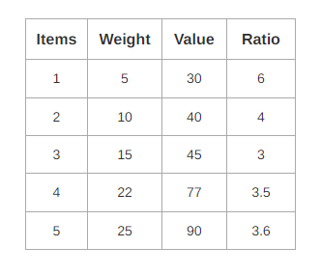
Example:
Step-01:
Compute the value / weight ratio for each item-

Slide 14
Example:
Step-02:
Sort all the items in decreasing order of their value / weight ratio-
I1 I2 I5 I4 I3
(6) (4) (3.6) (3.5) (3)

Slide 15
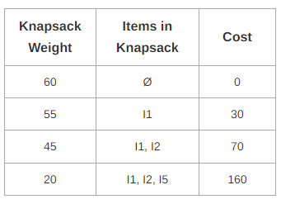
Example:
Step-03:
Start filling the knapsack by putting the items into it one by one.

Slide 16
Example:
Now, Knapsack weight left to be filled is 20 kg but item-4 has a weight of 22kg. Since in fractional knapsack problem, even the fraction of any item can be taken.
So, knapsack will contain the following items-
< I1 , I2 , I5 , (20/22) I4 >
Total cost of the knapsack
= 160 + (20/27) x 77
= 160 + 70
= 230 units

Slide 17
0/1 Knapsack Problem (2)
John assigns a profit p_{i} to item i
All weights and profits are positive numbers
John wants to select a subset of the n items to take
The weight of the subset should not exceed the capacity of the knapsack (constraint)
Cannot select a fraction of an item (constraint)
The profit of the subset is the sum of the profits of the selected items (optimization function)
The profit of the selected subset should be maximum (optimization criterion)
Let x_{i} = 1 when item i is selected and x_{i} = 0 when item i is not selected
Because this is a 0/1 Knapsack Problem, you can choose the item or not choose it.

Slide 18
Greedy Attempts for 0/1 Knapsack
Apply greedy method:
Greedy attempt on capacity utilization
Greedy criterion: select items in increasing order of weight
When n = 2, c = 7, w = [3, 6], p = [2, 10], if only item 1 is selected ➔ profit of selection is 2 ➔ not best selection!
Greedy attempt on profit earned
Greedy criterion: select items in decreasing order of profit
When n = 3, c = 7, w = [7, 3, 2], p = [10, 8, 6], if only item 1 is selected ➔ profit of selection is 10 ➔ not best selection!

